Slide 1
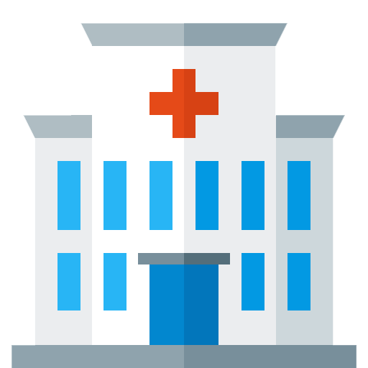
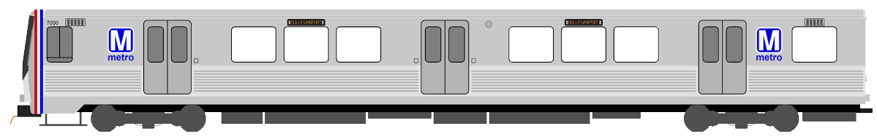
Narration:
The healthcare IT system is a complex environment where health information needs to be shared among thousands of providers. Let’s compare the healthcare environment to the subway system of a large city that helps people move from one location to another.
PRIMARY CARE
PHARMACY
SPECIALIST
DOCTOR
PHARMACY
HOSPITAL
DENTIST
DOCTOR
DOCTOR
DOCTOR
HOSPITAL
DENTIST
DOCTOR
HOSPITAL
PHARMACY
DOCTOR
DENTIST
DOCTOR
PHARMACY
DENTIST
PRIMARY CARE
LABORATORY
DOCTOR
HOSPITAL
PRIMARY CARE

Slide 2
In this examples the different subway lines represent the health exchange networks. Just like a subway line connect locations, health exchange networks provide the securely movement of clinical data among different health care providers, payers, researchers, and beneficiaries.
But just as the subway cars running on the red line cannot move to a different color line, providers cannot communicate with providers on different health exchange networks because eHealth Exchange networks use different communication protocols and legal agreements for their messages they send.
DirectTrust
NATE
MiHIN
eHealth Exchange
MiHIN
CommonWell

Slide 3
The different subway stations represent the health care providers, payers, researchers, and beneficiaries that need to exchange patient information.
These include organizations such as hospitals, pharmacies, primary care physicians, specialists, research organizations, public health organizations, insurance companies, Medicare, and care teams.
PRIMARY CARE
PHARMACY
SPECIALIST
DOCTOR
PHARMACY
HOSPITAL
DENTIST
SSA
DOCTOR
DOCTOR
HOSPITAL
NIH
CMS
HOSPITAL
PHARMACY
DOCTOR
DENTIST
DOCTOR
PHARMACY
DENTIST
PRIMARY CARE
PUBLIC HEALTH
DOCTOR
HOSPITAL
PATIENT PORTAL

Slide 4
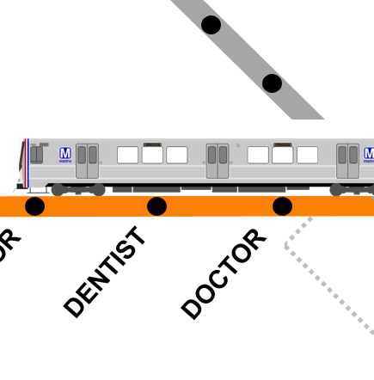
4
Subway cars securely move passengers from one location to another. Subway cars are the means by which information is shared on the health exchange networks between providers. Think of these cars as CONNECT or DIRECT messages, a gateway enabling the secure and effective exchange of healthcare information.
The various standard HL7 documents, such as CDAs, or FHIR message standards are the templates for the design of the passengers in the cars.
PRIMARY CARE
PHARMACY
SPECIALIST
DOCTOR
PHARMACY
HOSPITAL
DENTIST
DOCTOR
DOCTOR
DOCTOR
HOSPITAL
DENTIST
DOCTOR
HOSPITAL
PHARMACY
DOCTOR
DENTIST
DOCTOR
PHARMACY
DENTIST
PRIMARY CARE
LABORATORY
For example, a person travels from location A to location B in a subway car just like the patient data travels in a message from provider A to provider B, using HL7 standards based messages (CDA, FHIR) through an eHealth Exchange network.
In this process, the information needs to be semantically and syntactically consistent for it to be useful when it arrives at its destination.
DOCTOR
HOSPITAL
PRIMARY CARE

Slide 5

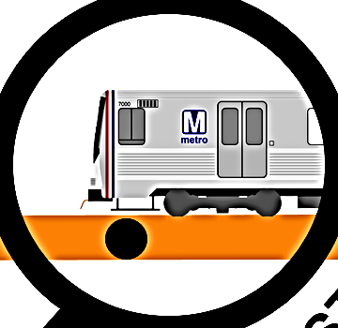
In this analogy, the passengers moving from one location to another are like the clinical data that needs to be moved from one provider to another.
This includes items like electronic health records (EHR), Patient Discovery (PD), Query for Documents (QD), and Retrieve Documents (RD).
Passengers traveling in the subway system are of different ethnicities, countries, and speak different languages (vocabularies and terminologies). In the same way, exchanges between different providers can encounter multiple semantic and technical challenges.
PRIMARY CARE
PHARMACY
Health Data
SPECIALIST
DOCTOR
PHARMACY
HOSPITAL
DENTIST
DOCTOR
DOCTOR
DOCTOR
HOSPITAL
DENTIST
PD
RD
EHR
DOCTOR
QD
HOSPITAL
PHARMACY
DENTIST
DOCTOR
PHARMACY
DENTIST
PRIMARY CARE
Implementation Guides (IGs) are the rails that keep the trains moving along in a consistent and controlled manner. The standard size rails allows the subway cars to go to the right places and align with all current and future destinations.
LABORATORY
DOCTOR
Just like a subway car needs to be designed to securely and comfortably transport passengers on standard tracks, health exchanges need to be designed so they can be securely send/ receive, and understand data, based on standards and guidelines put into place by Federal and international healthcare IT communities.
HOSPITAL
PRIMARY CARE

Slide 6
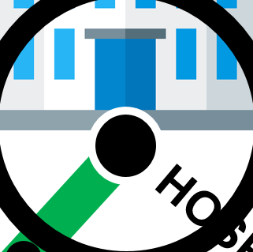
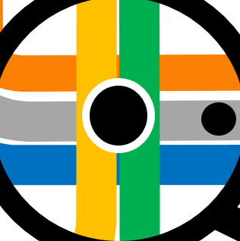
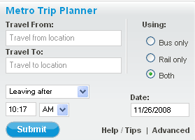
A blueprint shows the architecture, design, and related constrains needed to design all aspects of the subway system. The FHIM is a master metadata blueprint which also aligns standards in a comprehensive US uber information model, providing a starting point, guidelines, and tools needed by federal and state agencies, healthcare providers and researchers for the design and choreography of both healthcare information storage and transport while maintaining semantic and syntactic consistency.
FHIM provides an holistic, organic view of
39 healthcare domains and terminologies
IT systems designers and data architects have to provide guidance to software implementors based on all applicable standards as providers need to communicate with other providers using standard reference data and established international message protocols. Unlike our diagram, this planning is not limited to not just one city and subway system must be planned, but rather systems for all cities everywhere must be planned for effective interoperability.
The FHIM data model represents a trip planner that helps an organization define how people need to move, what the cars should look like, and what line to take in every city they need to visit now and in the future.
PRIMARY CARE
PHARMACY
SPECIALIST
DOCTOR
PHARMACY
HOSPITAL
DENTIST
DOCTOR
DOCTOR
DOCTOR
HOSPITAL
DENTIST
DOCTOR
HOSPITAL
PHARMACY
DOCTOR
DENTIST
DOCTOR
PHARMACY
DENTIST
PRIMARY CARE
LABORATORY
DOCTOR
HOSPITAL
PRIMARY CARE

Slide 7
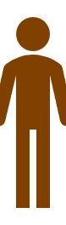

The FHIM is a tool for software implementers. It helps implementers with the design of the standard vocabularies and the FHIR resources. Since the FHIM is aligned to the HL7 FHIR data elements, items such as the interior layout of the cars, including design of chairs, windows and doors, are all guided by the FHIM classes in the various healthcare domains.
PRIMARY CARE
PHARMACY
SPECIALIST
DOCTOR
PHARMACY
HOSPITAL
DENTIST
DOCTOR
DOCTOR
DOCTOR
HOSPITAL
DENTIST
DOCTOR
HOSPITAL
PHARMACY
DOCTOR
DENTIST
DOCTOR
PHARMACY
DENTIST
PRIMARY CARE
Narration:
Much like a subway car cannot easily switch lines, health data doesn’t move easily from a health exchange network to another because of the different used standards and protocols.
FHIM knows how to translate from multiple standards and The FHIM knows how to transform among multiple standards and protocols such as FHIR, CIMI models, and various CDA structures. Its supportive tooling, MDHT, eliminates manual creation of Implementation Guides for the HL7 document standards (CDAx). Manual procedures introduce errors, which are difficult and time consuming to find. This gives us reliable, smooth and uniform rails on which to travel.
LABORATORY
DOCTOR
HOSPITAL
PRIMARY CARE

Slide 8
Passengers that are transported on the subway system are different and speak different languages. When they reach their destination, they often need a translator.
Similarly, healthcare data often needs to be mapped from one vocabulary to another for the data to be useful.
The FHIM provides an integrated picture of a data model, standards information, standard reference terminologies and architectural tools needed for an implementor to design applications using various HL7 standards such as CDA documents and FHIR resources.
PRIMARY CARE
PHARMACY
SPECIALIST
DOCTOR
PHARMACY
HOSPITAL
DENTIST
DOCTOR
DOCTOR
DOCTOR
HOSPITAL
DENTIST
DOCTOR
HOSPITAL
PHARMACY
DOCTOR
DENTIST
DOCTOR
PHARMACY
DENTIST
PRIMARY CARE
LABORATORY
DOCTOR
HOSPITAL
PRIMARY CARE

Slide 9
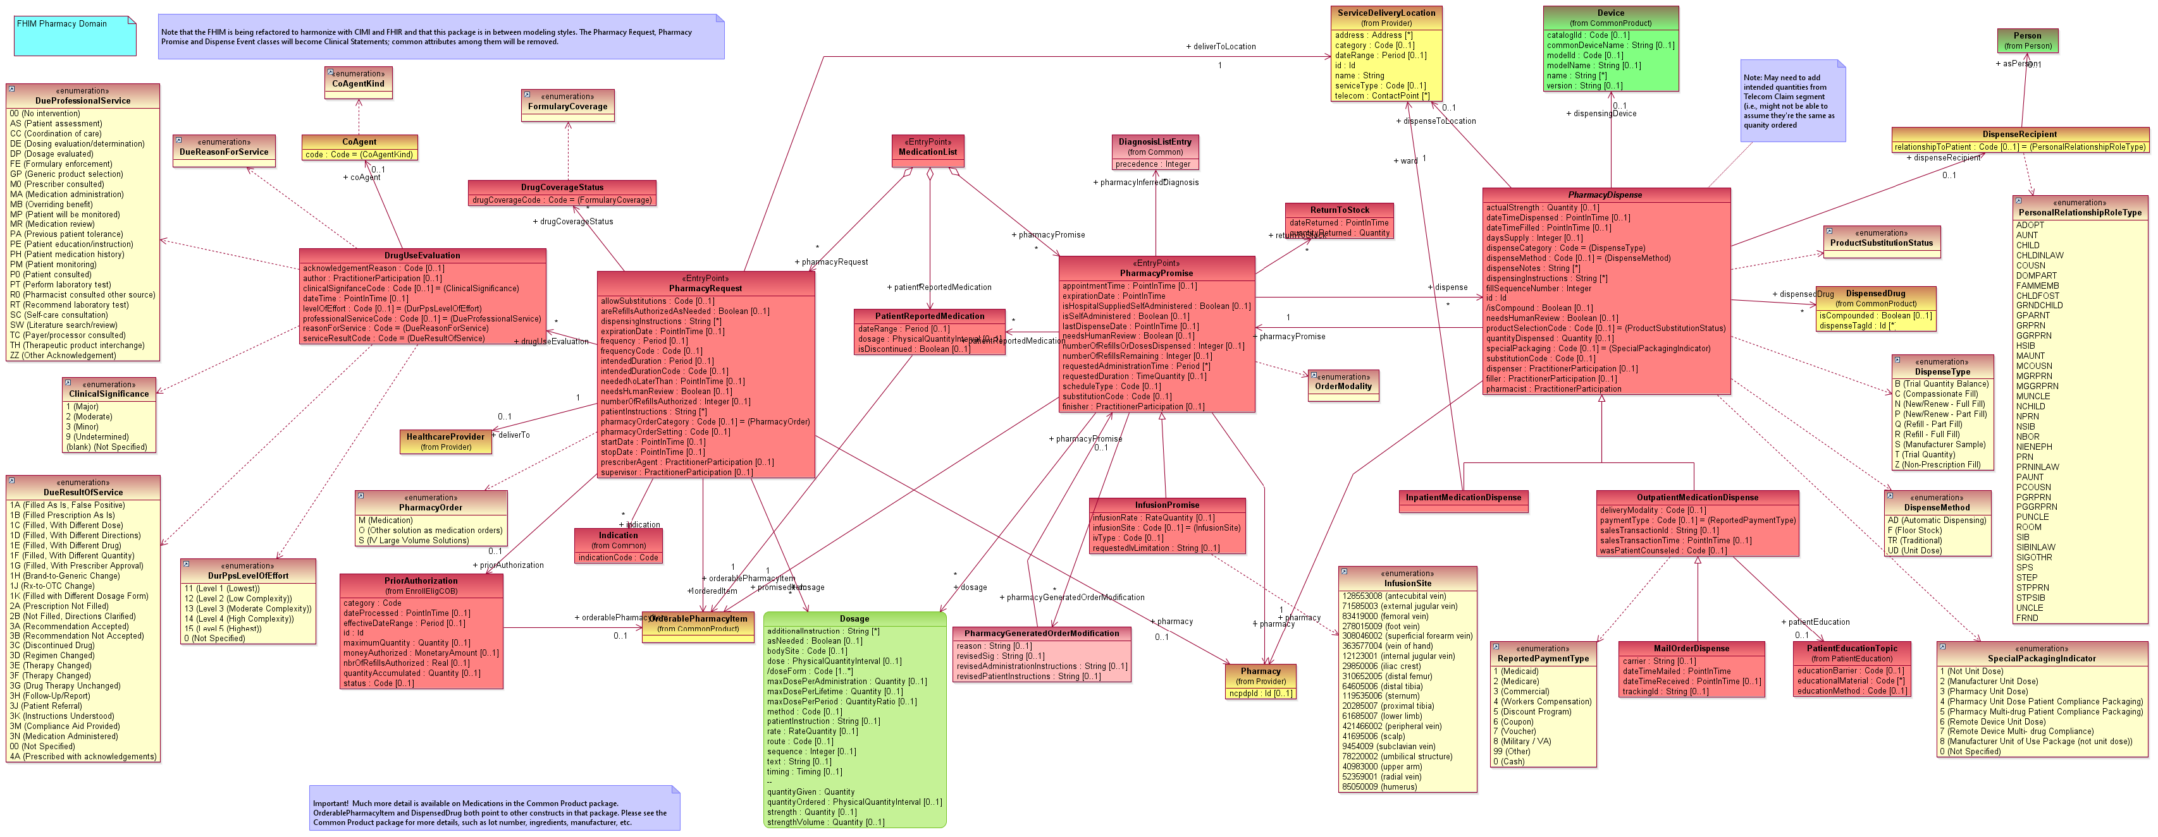
FHIM benefits
By providing a US and globally vetted view of the highly complex and ever changing healthcare environment, the FHIM data model provides the deep and consolidated metadata and tools needed in the coming years to build cost and time saving solutions. It is a bridge to future AI solutions. A picture of the Pharmacy model is shown below from the FHIMS.org collaborator's website.

